Slide 1
OPERATIONAL AMPLIFIER
Dr Ariya Saraswathy
Assistant Professor
Department of Physics
V T M NSS College
Thiruvananthapuram

Slide 2
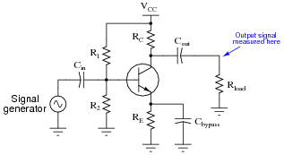
AMPLIFIER
It is an electronic circuit or device which increases the amplitude of a signal

Slide 3
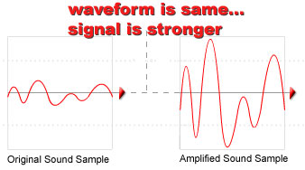

Slide 4
OPERATIONAL AMPLIFIER (Op Amp)
Historically an Op Amp was designed to perform such mathematical operations as addition, subtraction, integration and differentiation. Hence the name Operational Amplifier.

Slide 5
Background
Originally invented in early 1940s using vacuum tube technology
Initial purpose was to execute math operations in analog electronic calculating machines
Shrunk in size with invention of transistor
Most now made on integrated circuit (IC)
Huge variety of applications, low cost, and ease of mass production make them extremely popular

Slide 6
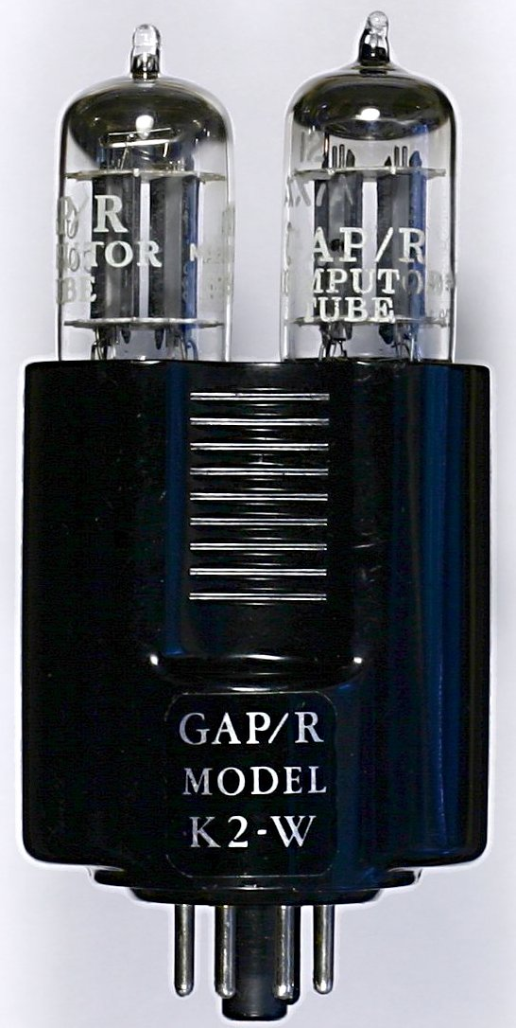

Slide 7
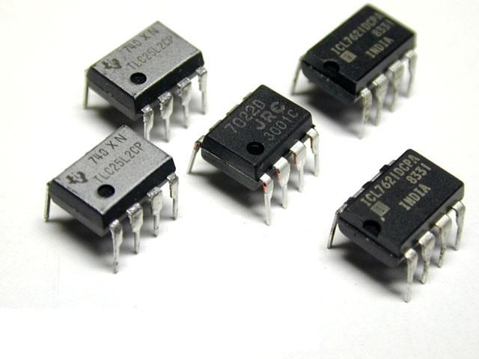
ICs

Slide 8
Fairchild Semiconductors
µA 702 (1963)
µA 709 (1965)
µA 741 (1968)
µA 748 (1968)
National Semiconductors
LM101 (1967)
LM101A (1968)
LM107 (1968)
LM324 (1974)

Slide 9
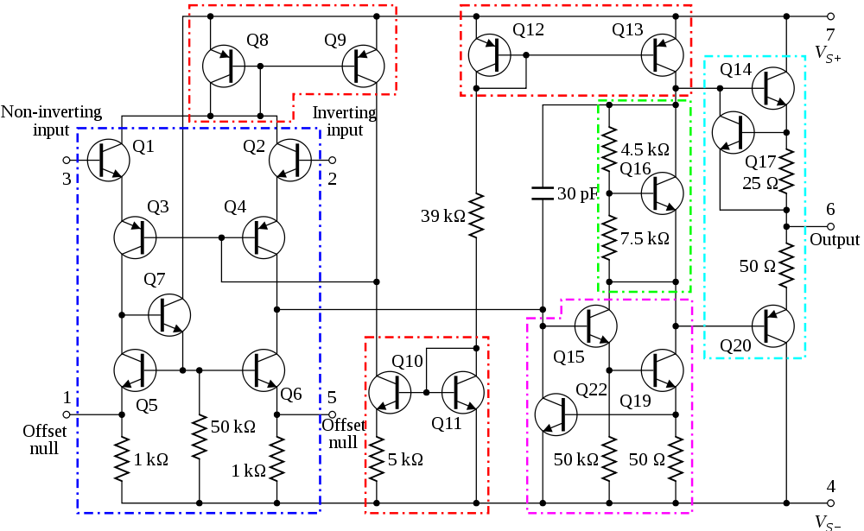
741 Op-Amp –Internal Circuitry

Slide 10
Op Amp – A multistage Amplifier
Differential Amplifier stage
High gain CE amplifier stage
Class B push pull emitter follower
Differential Amplifier
More stages of gain
Class B Push pull Amplifier

Slide 11
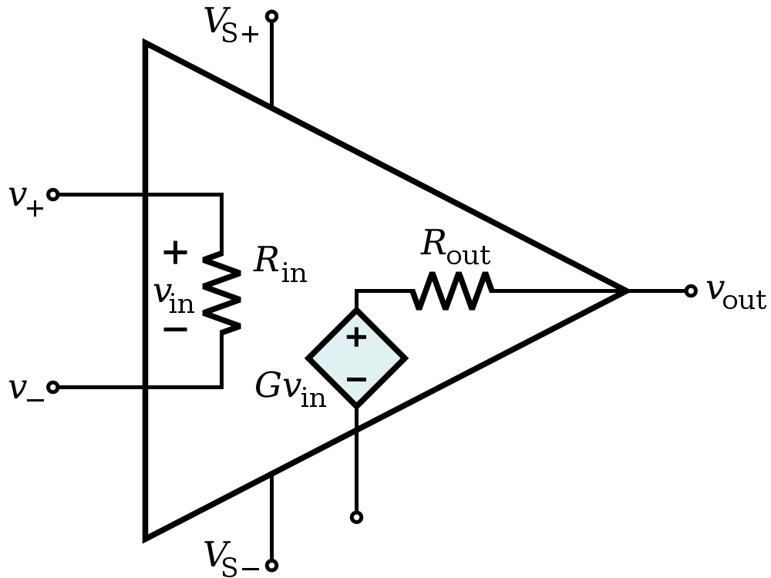
Op Amp Equivalent Circuit

Slide 12
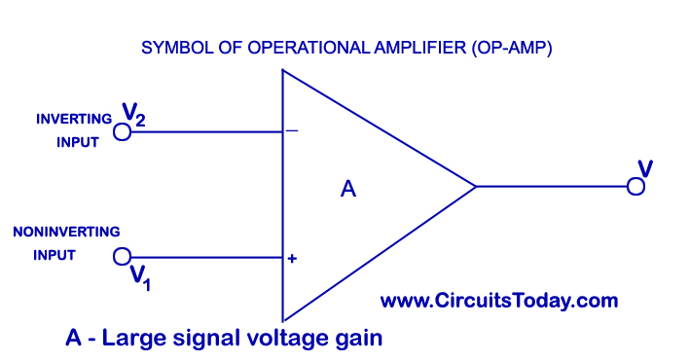

Slide 13
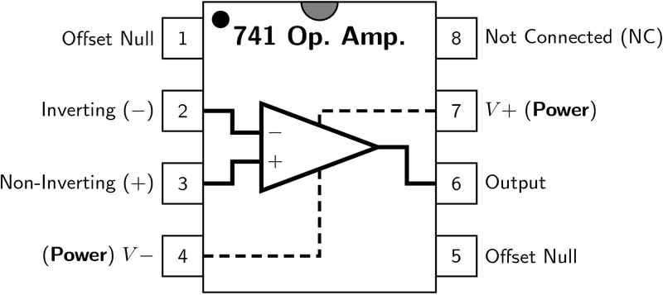

Slide 14
Ideal Op Amp
Z_{in} = ∞
Z_{out} = 0
A_{V} = ∞
Practical Op Amp
Z_{in} = 2MΩ
Z_{out} = 100Ω
A_{V} = 10⁵

Slide 15
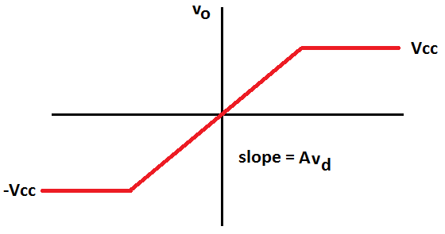
Voltage Transfer Characteristic
Range where we operate the op amp as an amplifier.
V_{in}

Slide 16
APPLICATIONS

Slide 17
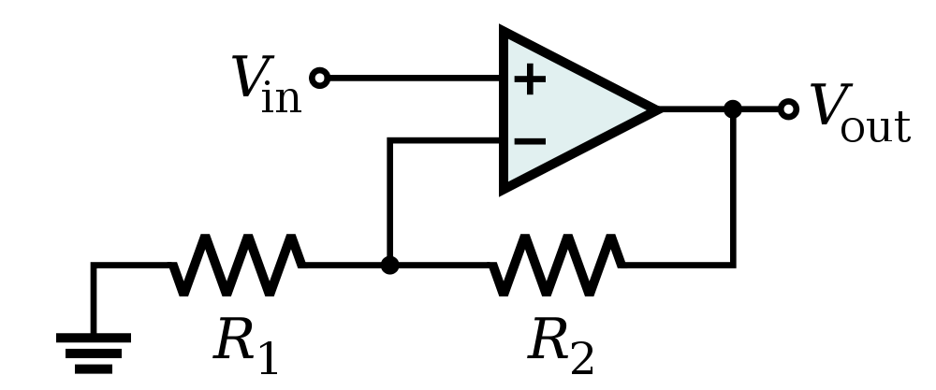
Non-Inverting Amplifier

Slide 18
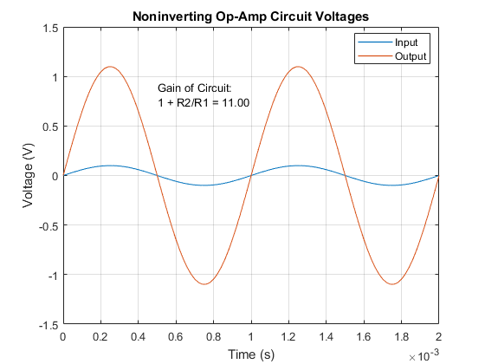

Slide 19
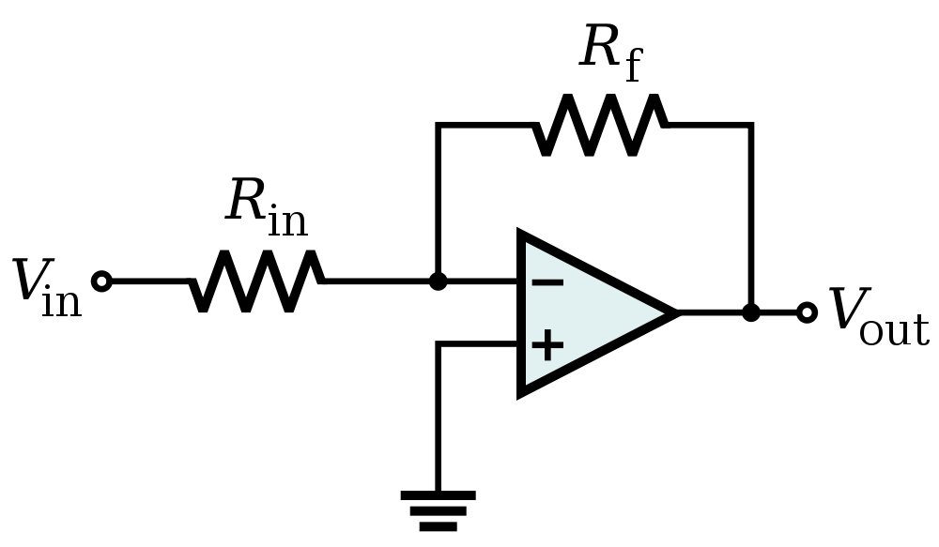
Inverting Amplifier

Slide 20
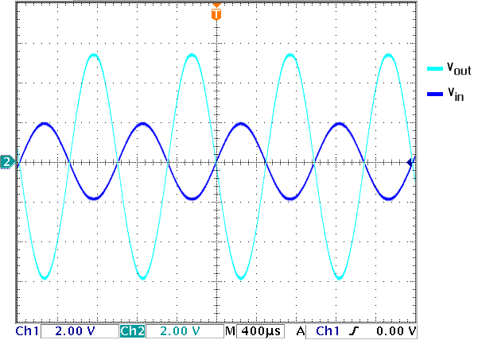

Slide 21
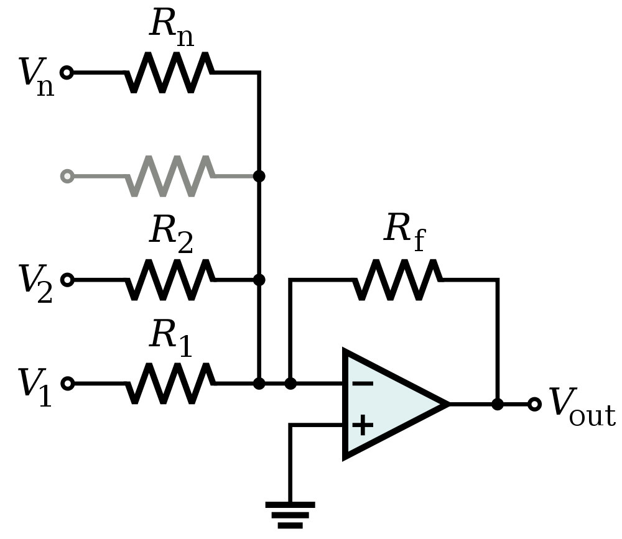
Op-Amp Summing Amplifier

Slide 22
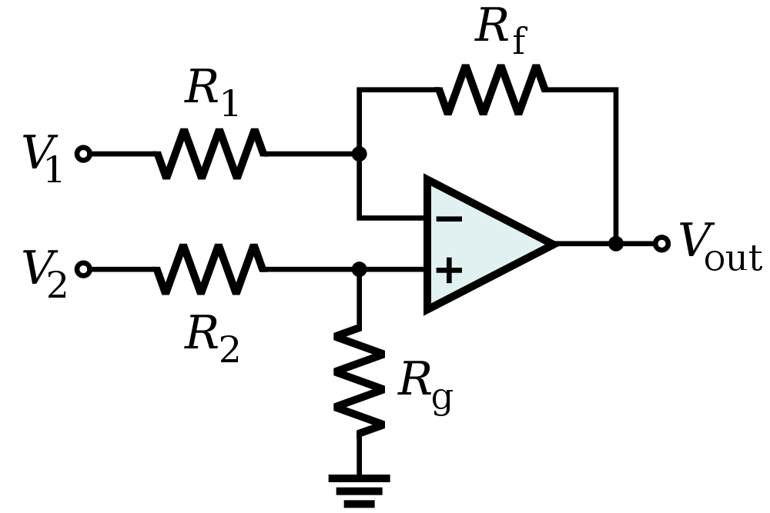
Op-Amp Differential Amplifier
If R₁ = R₂ and R_{f} = R_{g}:

Slide 23
Op-Amp Integrator
V_{o} = -

Slide 24
Op-Amp Differentiator

Slide 25
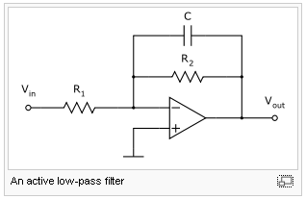
Low-pass Filter (active)
Cutoff frequency
This works because the capacitor needs time to charge.

Slide 26
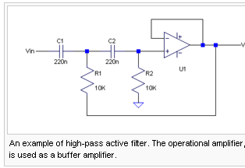
High pass filter (active)

Slide 27
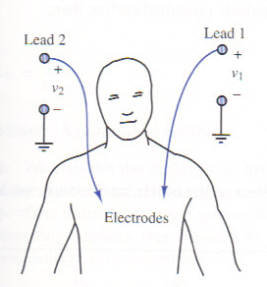
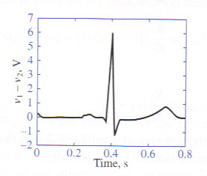
Applications of Op-Amps
Electrocardiogram (EKG) Amplification
Need to measure difference in voltage from lead 1 and lead 2
60 Hz interference from electrical equipment

Slide 28
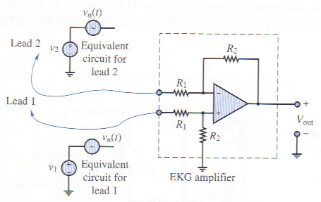
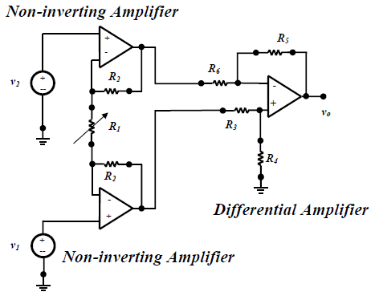
Simple EKG circuit
Uses differential amplifier to cancel common mode signal and amplify differential mode signal
Realistic EKG circuit
Uses two non-inverting amplifiers to first amplify voltage from each lead, followed by differential amplifier
Forms an “instrumentation amplifier”

Slide 29
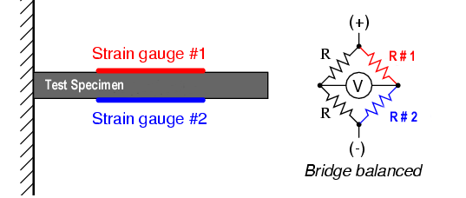
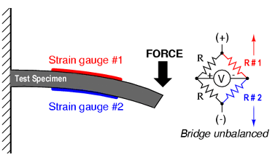
Strain Gauge
Use a Wheatstone bridge to determine the strain of an element by measuring the change in resistance of a strain gauge
(No strain) Balanced Bridge
R #1 = R #2
(Strain) Unbalanced Bridge
R #1 ≠ R #2

Slide 30
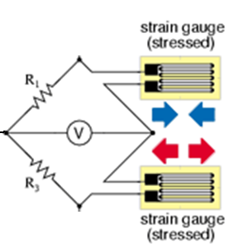
Half-Bridge Arrangement
Op amp used to amplify output from strain gauge
R + ΔR
R_{f}
R
V_{ref}
+ V_{cc}
+
-
+
+
V₀
__
-
R
- V_{cc}
R - ΔR
R_{f}
Using KCL at the inverting and non-inverting terminals of the op amp we find that ➔
ε ~ V_{o} = 2ΔR(R_{f} /R²)

Slide 31
Op Amps Applications
Audio amplifiers
Speakers and microphone circuits in cell phones, computers, mpg players, boom boxes, etc.
Instrumentation amplifiers
Biomedical systems including heart monitors and oxygen sensors.
Power amplifiers
Analog computers
Combination of integrators, differentiators, summing amplifiers, and multipliers

Slide 32
THANK YOU

